Slide 1
Data Engineering and Management
A workshop within the Data-Centric Engineering scheme

Slide 2
Versioning for Data-Centric Engineering
The uses and benefits of versioning to help with DCE
Notes:
Introduce versioning as a general concept

Slide 3
The problem:
Final_this_oneFINAL_v3.py
Script evolution is an iterative process
Versioning software’s such as git provides a solution that can track and manage changes
Notes:
Explain the problem and ask for examples

Slide 4
What is Versioning
Track file changes over time
Records who changed what, when and why
Maintains single source of truth
Replaces manual file-duplication backups
Notes:
Give a general explanation of versioning and explain how it can fix the problem

Slide 5
Where is versioning used
Whenever you use Ctrl-Z
Word etc.
Solidworks Cloud, onShape
Notes:
Ask for any examples of where people know of it

Slide 6
Why do I want versioning?
Cloud backup
Easy experimentation through branching
Instant recovery from breaking bugs
Clear accountability and team collaboration
Notes:
Talk through the uses of it and the reasons to try and get people to realise that the cost of setting it up is worth it

Slide 7

What is a snapshot/commit
A recorded state of an entire project at a moment in time
Each commit comes with a message explaining what happened
A continuous linked chain of history
Notes:
Set the stage and explain what a snapshot/commit it to help people understand the background of git

Slide 8
Software’s available
Git (industry standard)
Perforce / unity VC (for game development)
SVN (legacy standard)
OnShape (Cloud CAD)
Notes:
Explain branching both for teams and personal uses

Slide 9

Git vs Github
A local software
Used to track history and file changes
Takes snapshots (commits)
A web-based hosting platform
Enables safe collaboration in real time
Acts as a central backup
Notes:
Explain the difference and highlight where to use one or the other

Slide 10
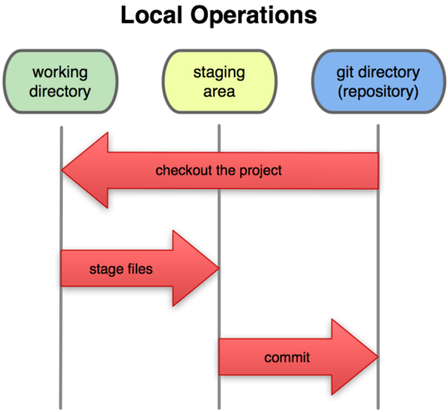
How does Git work
You work as normal in your folder
You can stage “good” changes to be committed
You can commit your code to your repo for it to be used
Notes:
If you want go onto your files and make a bad edit and then revert it

Slide 11
Git CLI (terminal) Functions
Git init
  Ran in the root folder of a project
Git add .
  The . adds all changes into the current commit but this can be file specific
Git commit –m “<message>”
  This is how you take a “snapshot” of the code
Git push/pull
  Use this to sync your code with remote servers like github or gitlabs
Notes:
Go through these, breaking down the commands

Slide 12
Commit Messages
Type | When to use it | Example
Feat | A new feature or capability added to the codebase | Feat(auth): add OAuth2 support
Fix | A bug fix | Fix(solver): resolve matrix convergence crash
Docs | Documentation-only changes (README, wiki, comments) | Docs: update setup instructions to README
Refactor | A code change that neither fixes a bug or adds a feature | Refactor: simplify mesh generation loop
Perf | A code change that improves performance | Perf: vectorize distance calculation algorithm
Chore | Routine tasks, build tracking or dependency updates | Chore: bump numpy version to 1.26
Test | Changes made to tests | Test: add unit tests for boundary conditions
CI | Changes made to CI config files and scripts | Ci: fix GitHub actions workflow syntax
<type>[optional scope]: <description>
[optional body]
[optional footer(s)]
Notes:
Give people some examples and get them to work out the commit messages

Slide 13
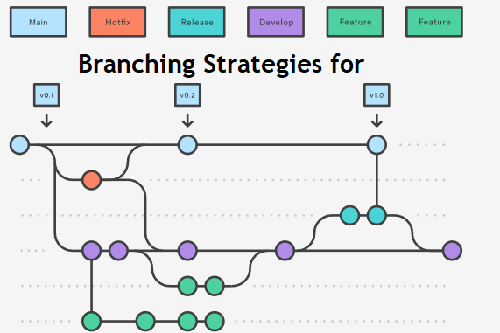
Branching
Branching creates a safe, parallel workspace in your project where you can experiment with new code or features without breaking your main, working version.
Git branch <name>
  Create a branch to work
Git branch
  See all branches
Git merge
  Merge your changes to another branch
Notes:
Explain branching both for teams and personal uses

Slide 14
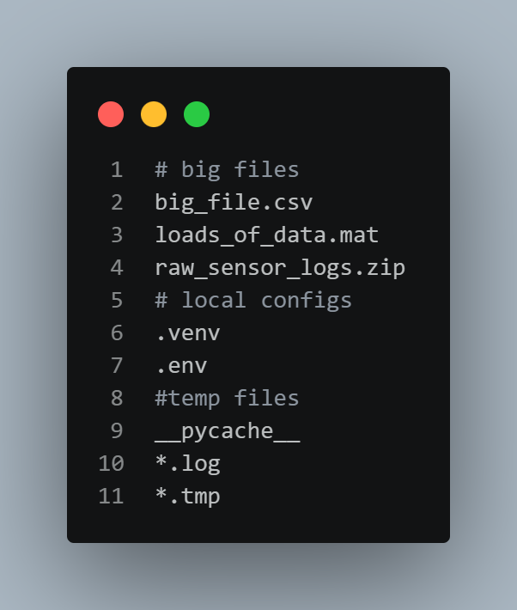
What is .gitignore
Not everything needs to be tracked in git
Files above 100MB should be avoided
Large or unnecessary files shouldn’t be included

Slide 15
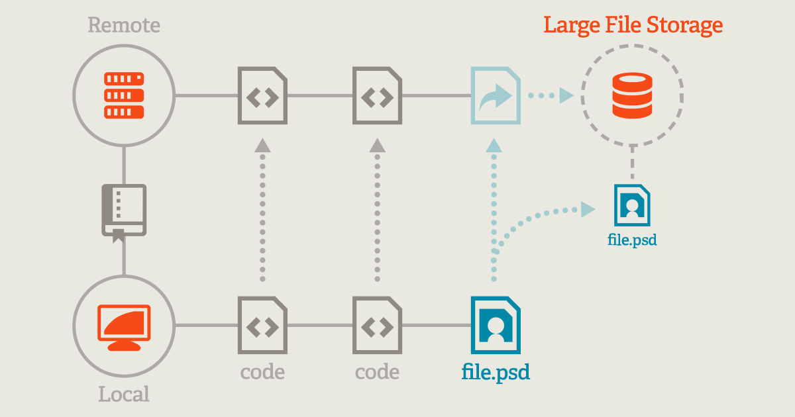
Git Large File Storage (LFS)
Git LFS swaps heavy files in your local project folder with tiny 130-byte text metadata pointers.
When pushing your work, the actual binary gets redirected straight to LFS storage servers, bypassing Git's core history.
Notes:
Explain uses of this in DCE, get people to talk through examples etc

Slide 16
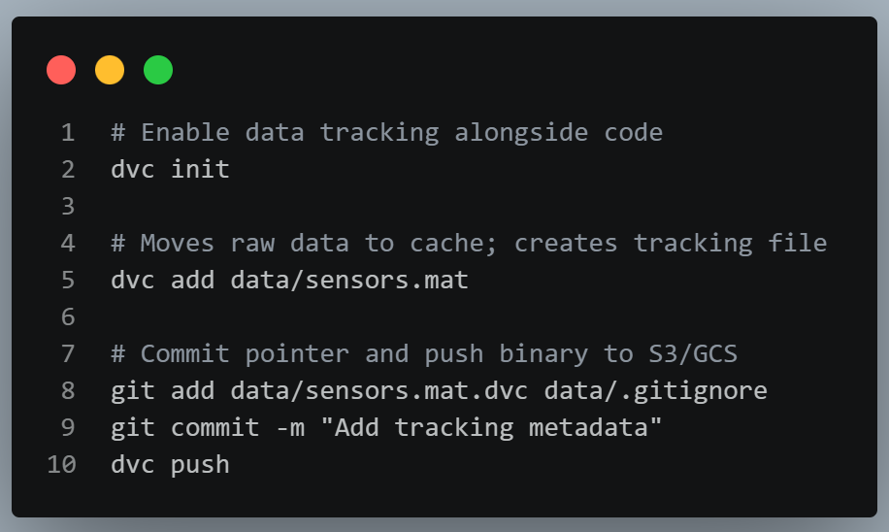
Data Version Control (DVC)
DVC tracks massive datasets and neural network weights by generating tiny human-readable tracked .dvc metafiles.
The actual multi-gigabyte binaries are seamlessly pushed to central cloud buckets (S3, Google Cloud Storage, Azure).
Notes:
Explain DVC and PDM for use in CAD too

Slide 17
LFS vs DVC
Feature | Git LFS | DVC
Primary use | Large files (binaries) | Datasets, models, pipelines
Cloud agnostic | Requires LFS server | Works with S3, Azure, etc
Pipeline support | None | Strong dependency tracking
Complexity | Set and forget | Additional ClI tool management

Slide 18
How can you use versioning
A time-saver
A cloud backup
A problem solver
…

Slide 19
Take home
Git is like a time machine
Commit small and commit often
Write useful commit messages
Never panic, almost everything in git can be undone and it can always save your bacon
Any Questions??

Slide 20
Data Engineering and Management
How to deal with data as a good engineer

Slide 21
Download the code
git clone https://github.com/JFrusher/DCE-code-workshops.git
cd DCE-code-workshops
pip install -r requirements.txt

Slide 22
What is Data Engineering and Management
Data handling
Data cleaning
Data ingestion and architecture
Data structuring
Governance, security and ethics

Slide 23
What is Data?
Stored in raw bites like 0100001
65, A, a little bit red – encoding standards
Stored in RAM for temporary use
Permanently stored in non-volatile storage such as hard drives or SSDs
Structured storage such as databases, semi-structured like emails, or unstructured like JPEGs, PDFs,etc
Pixel based vs character based

Slide 24
What Happens to Data
Loading
  Batch processing
  Stream processing
Cleaning
  Parsing
  Filtering
  Anonymizing
Storing
  Data lakes
  Databases
  RAM
Using
  Analytics
  Machine learning
  Application serving

Slide 25

The Problem
A charity called Legs Legs Legs has provided you with some data they got from patient forms about prosthetic implantations, but the data is messy and you need to fix it before returning it to them.

Slide 26
Data Collection - Inputs
Physical sensor and industrial telemetry
  Mechanical sensors
  Thermal sensors
  Fluid sensors
  Biomedical sensors
Human-input and form-based systems
  Google forms
  Manual logged data
Software Logs
Geospatial & environmental sensing
Digital twin or emulated data

Slide 27
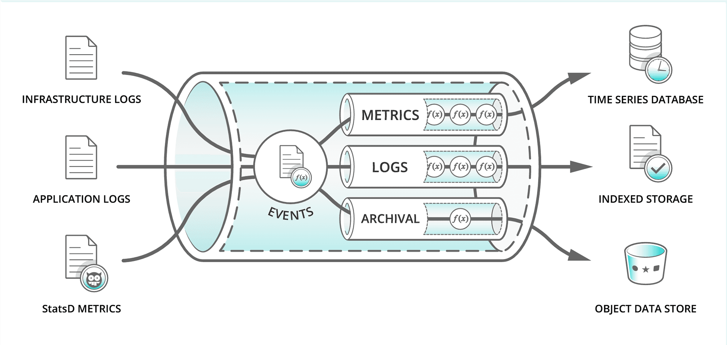
Data Pipelines
An automated software system that moves raw data from one or more sources, transforms it into a usable state and delivers it to a destination for storage, analysis or action

Slide 28
Data Pipelines
ETL (Extract, Transform, Load)
Cleaned before storage
Strips sensitive data early
Rigid schema structure
Filters out noise
Best for regulated data
ELT (Extract , Load, Transform)
Cleaned after data loading
Downstream privacy controls required
Flexible schema
Retains raw telemetry
Best for fast IoT streams

Slide 29
Data Pipelines - Privacy
ETL (Extract, Transform, Load)
Essential for handling sensitive, regulated datasets like patient forms
Sensitive attributes and identifiers are transformed or omitted before storage
ELT (Extract , Load, Transform)
Loads raw non-anonymised telemetry directly into data lakes – high speed
Mandates strict row-and-column access controls to guarantee data isolation prior to transformation.

Slide 30
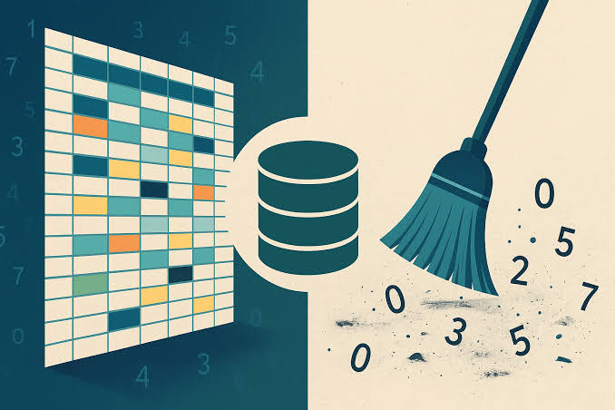
Data Cleaning
Why do we clean data?

Slide 31
Data Cleaning – Missing Data
Nulls, NaNs, Blanks
Dealt with by either dropping rows or using imputation
Statistical Imputation
  Filling blanks with either the columns mean( for normally distributed numbers), median (if data is skewed) or a similar interpolation
Time series Imputation
  For streaming sensor data, we use forward fill (Ffill) which carries the last good reading forward
Notes:
Where do we get Nulls, Nans etc, which statistical imputations should be used for which columns etc and what could be the bad things of Ffill leading onwards to next slide

Slide 32
Data cleaning - Inconsistencies
String harmonization
Strings are systematically forced to lowercase and stripped of trailing spaces: .str.lower().str.strip()
Regex stripping can remove textual noise (May 12th 2024 → May 12 2024)
Mixed Format Parsing Engines use smart parsers such as: pd.to_datetime(df['date'], format='mixed') to translate disparate strings into a unified standard, such as ISO 8601 (YYYY-MM-DD)
Notes:
Where could this happen? Explain what strip and lower does and talk about the available smart parsers

Slide 33
Data Cleaning – Outliers, Noise and Spikes
Domain-specific knowledge
  Apply hard limits based on engineering realities, any value outside the predicted range can be clipped or treated as Nan
Statistical Filters
  Give the data a range of standard deviations from the average before a data point is treated as an outlier
Rolling Filters
  For Noisy sensor streams it can be worth replacing each datapoint with the average of its local window (e.g. a 5 second window)
Notes:
Ask for examples of domain specific knowledge, talk about IQR filters and where appropriate to use
Talk about places to use rolling filters

Slide 34
Data cleaning – Ethics
Automatically filling empty patient ages using standard column averages masks collector faults and biases demographics
Harmonizing causes of amputation (e.g., standardizing text inputs) ensures minor patient groups stay visible
Notes:
Give the example of less tech savvy older patients may forget to enter their age to by harmonizing you destroy this data.

Slide 35
How and why do we store data
Volatile and Non-volatile storage
  Latency
  Throughput
  Capacity
  Persistence
We store data to manage State or the current condition of a system or application at any given moment

Slide 36
Plain text vs Binary
2,147,483,647
In plain text this is 00110010 00110001 00110100 00110111 00110100 00111000 00110011 00110110 00110100 00110111
In a 4-bit signed integer this is 01111111 11111111 11111111 11111111
A processor can’t do anything with the plain text number without converting it to an integer first

Slide 37
Databases: In-memory data
CSV
  Plain text, comma separated table format
.mat
  Binary format for multi-dimensional matrices
DataFrames
  An In-memory tabular programmatic structure
Notes:
Give uses for all of these, explain mat is matlab and inbuilt to system and df within pandas – library within py

Slide 38
Databases
SQL
  SQL, PostgreSQL, SQLite
  Relational tables with rigid schemas
NoSQL
  Flexible unstructured document storage
  Doesn’t need the same columns, scales horizontally
  Document store
Queries
  SELECT, INSERT, UPDATE, DELETE
  SELECT column1, column2
  FROM table_name
  WHERE condition;
  ORDER BY, LIMIT
Notes:
Explain sql, queries and databases from basics. DBs need columns and rows,

Slide 39
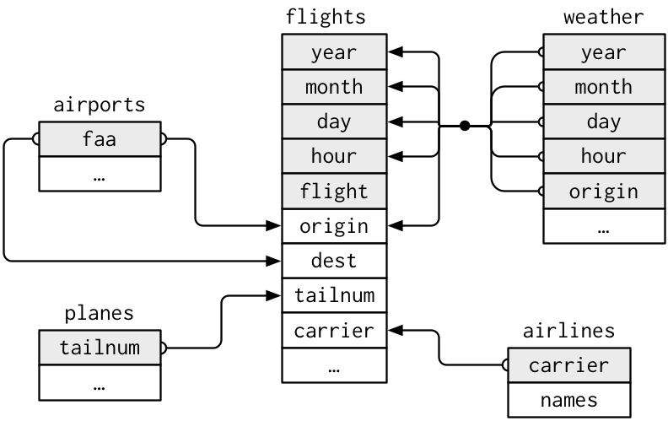
Relational Data
Organized in rows and columns
Connected using unique keys – keyed row
Strict, predefined structural schemas
Guarantees data consistency (ACID)
Queried using standard SQL
Notes:
Go back to basics with sql

Slide 40
Minimization via Relational Data
Relational databases enforce type safety and strict format validation at the database boundary.
Separate clinical telemetry logs from asset metrics.
Least privilege access
Notes:
IAM priorities, principle of minimum permisions

Slide 41
Cyber Security
Python hashing anonymizes patient PII
  def anonymize_name(value):
  normalized_value = str(value).strip().lower()
  return hashlib.sha256(normalized_value.encode('utf-8')).hexdigest()
Encrypt data at rest/transit
Strict role-based access control
Collect only necessary data
Maintain detailed audit logs
Salt configuration patterns and dictionary mappings must be kept physically isolated to secure tokens against decryption attacks.
BW COLOR XXX
Notes:
Talk about cyber risks and mitigations, explain hashing, one way but also 121

Slide 42
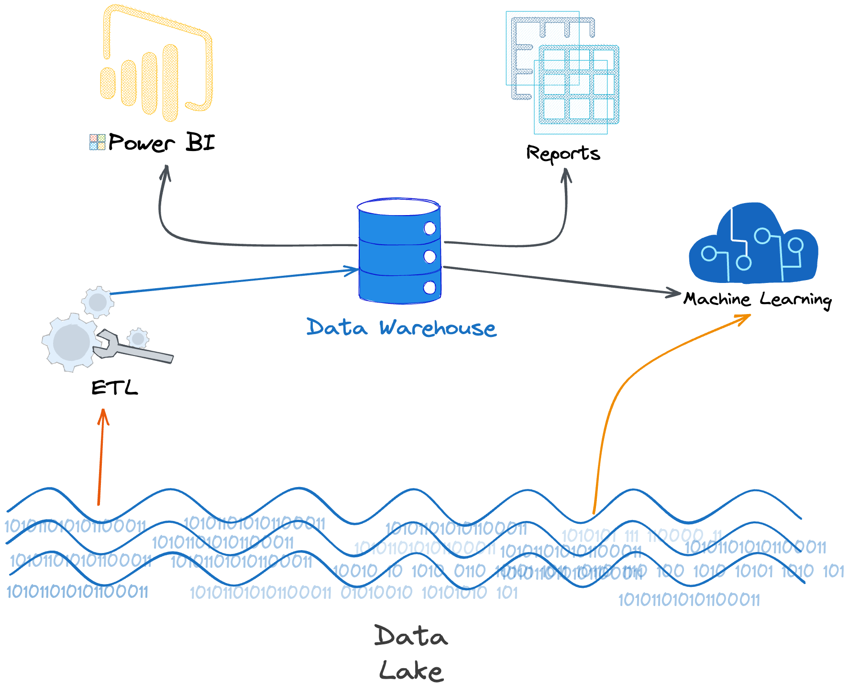
Cloud Computing
Scalable storage for hosting raw data
On-demand Processing power for transformations
Separate compute and data lakes
Notes:
AWS, MS azure, google cloud
Explain data lakes, processing and lakehouses

Slide 43


